Slide 1


Disaster Detection Using Social Media
Project 3 - GA-DSI
-Ram Rallabandi
Project -5 - GA
Farnaz & Ram

Slide 2
Project Goal:
Problem Statement : Leveraging Social Media to Map Disasters.
Process:
Data Collection: Twitter API, Snscrape, Twint, Tweepy
Data Cleaning and EDA
Preprocessing and Modeling
Evaluation
Conclusion

Slide 3
Data Collection
Data Collection
Words of Natural Disaster in North America
Earthquakes
Mudslides
Floodings
Hurricanes
Tornadoes
Extracted
170,000 Tweets of based on Natural Disaster words
Credit: Common Natural Disasters in North America : https://trapbag.com/natural-disasters-north-america/

Slide 4
Data Cleaning & Pre-processing
Cleaning:
Using regex function to clean data
Removal of html, hyperlinks, punctuations, words less than 2 characters, words starting with numbers
Dropping the duplicates and not necessary columns
Pre-processing:
Lemmatization
Train and Split data with stratify - “Yes”, random_state - “42”

Slide 5
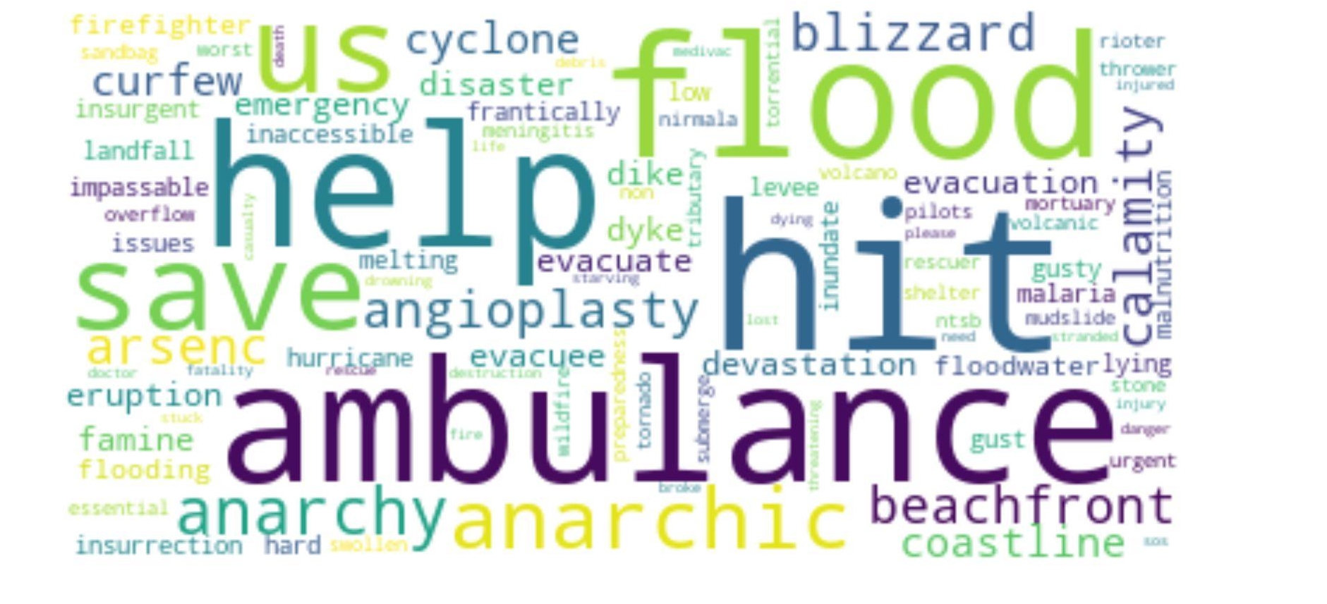
EDA : Most Frequent words during Emergencies
Credit: Emergency Words https://link.springer.com/article/10.1007/s10796-018-9843-x

Slide 6
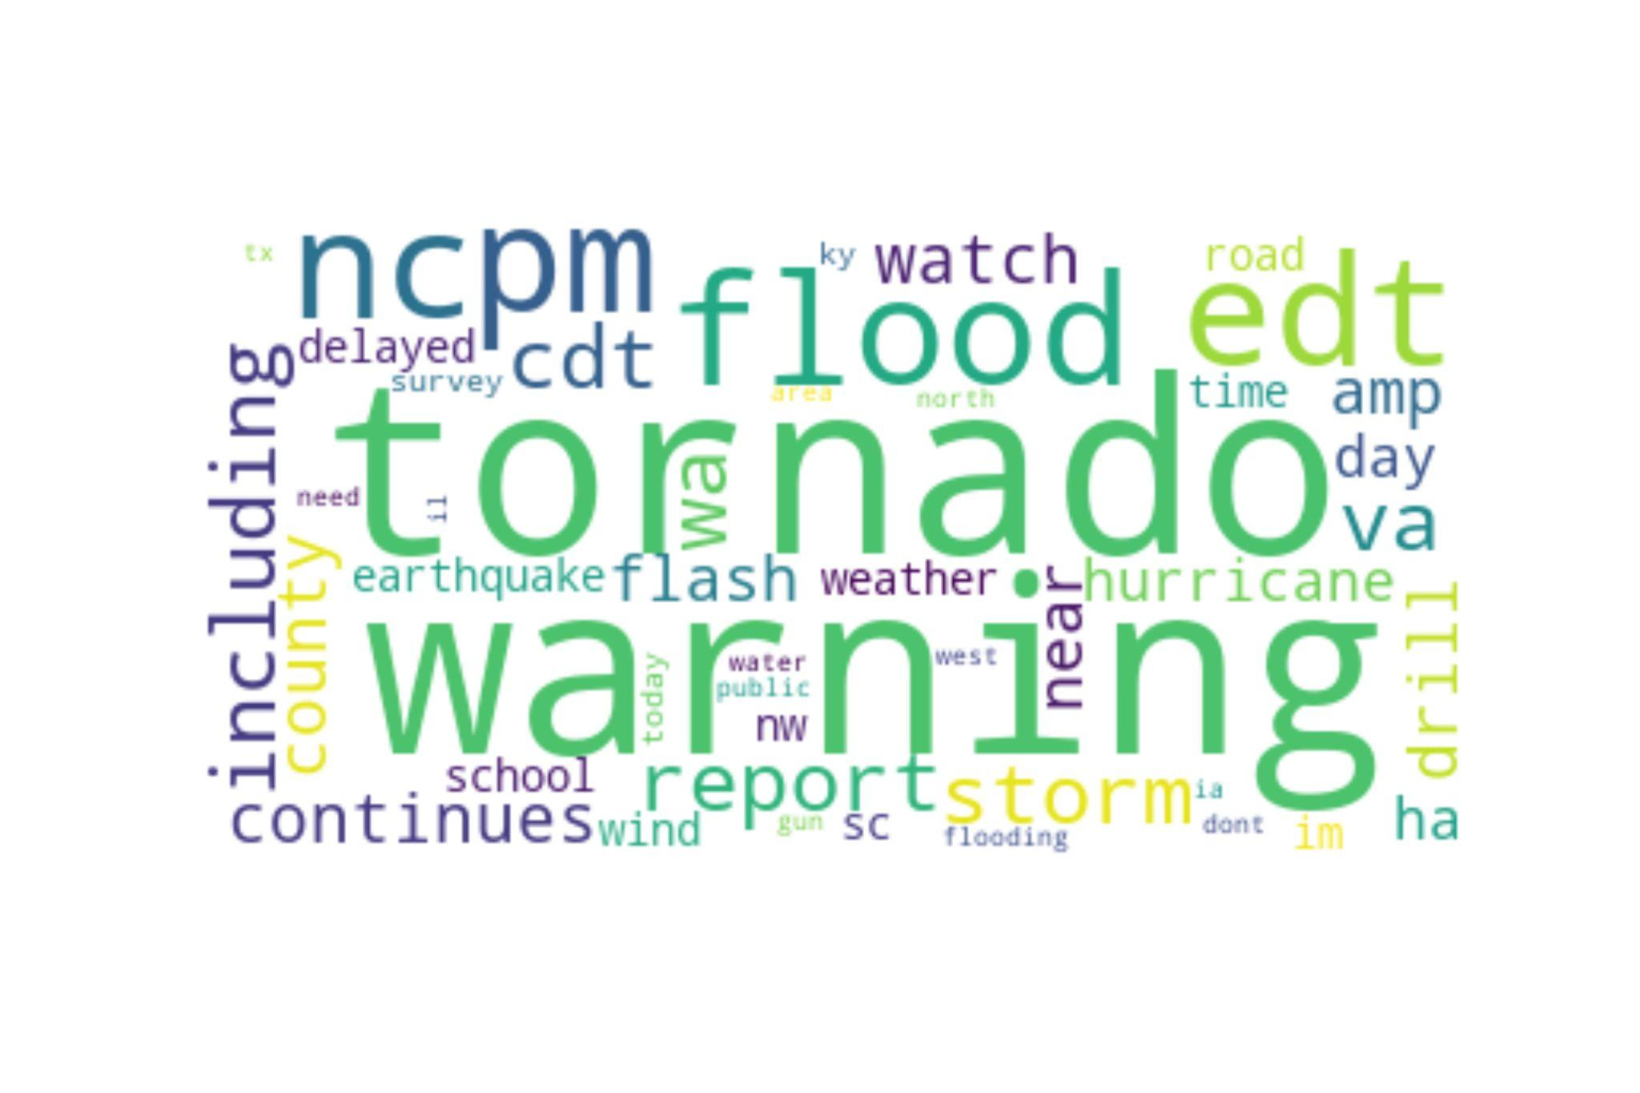
EDA : Most Frequent words from Tweets Search on Natural Disaster that are real threat

Slide 7
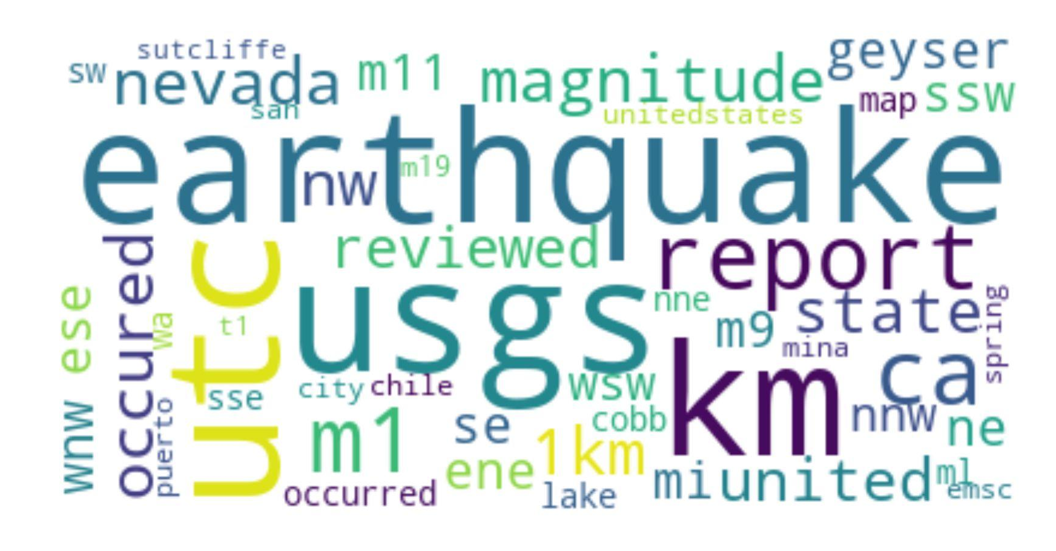
EDA : Most Frequent words from Tweets Search on Natural Disaster that are not threat

Slide 8
Data Pre-processing
Stop Words:
We have used 318 English words list from sklearn _stop_words
Continued to use the same set of stopwords for RandomForest and rest of the models

Slide 9
Models & Tuning
Model 1: Using GridSearchCV for CountVectorizer and Logistic Regression
Best Estimator:
Max_df = 0.95,
Max_Features = 6000,
Min_df = 2
N_gram_range (1,3)
Train / Test Score (25 % Test Data)
Training - 0.9978
Test - 0.9734
Confusion Matrix
True Negatives: 535
False Positives: 10
False Negatives: 15
True Positives: 383

Slide 10
Models & Training
Model 2: Using GridSearchCV for TF IDF and Logistic Regression
Best Estimator:
Max_df = 0.95,
Max_Features = 1000,
Min_df = 2
n_gram(1,3)
Train / Test Score (25 % Test Data)
Training - 0.9766
Test - 0.9490
Confusion Matrix
True Negatives: 535
False Positives: 10
False Negatives: 15
True Positives: 383

Slide 11
Models & Tuning
Model 3: Using CountVectorizer for BernoulliNB, MultinomialNB, GaussianNB
Bernoulli - Train / Test Score
Training - 0.9289
Test - 0.9564
Bernoulli - Confusion Matrix
True Negatives: 488
False Positives: 57
False Negatives: 10
True Positives: 388
Multinomial- Train / Test Score
Training - 0.9610
Test - 0.9247
Multinomial - Confusion Matrix
True Negatives: 482
False Positives: 63
False Negatives: 8
True Positives: 390
Gaussian- Train / Test Score
Training - 0.9989
Test - 0.9353
Gaussian - Confusion Matrix
True Negatives: 501
False Positives: 44
False Negatives: 17
True Positives: 381

Slide 12
Models & Training
Model 4: Using CountVectorizer for RandomForest
Best Estimator:
Max_depth = 30,
n_estimators = 500,
Min_samples_leaf : 1
Min_samples_split: 10
Train / Test Score (25 % Test Data)
Training - 0.9483
Test - 0.9183
Confusion Matrix
True Negatives: 475
False Positives: 70
False Negatives: 7
True Positives: 391

Slide 13
Model 5: Using CountVectorizer for Support Vector Machine
Best Estimator:
Kernel : linear
Train / Test Score
Training - 0.9996
Test - 0.9671
Confusion Matrix
True Negatives: 537
False Positives: 8
False Negatives: 23
True Positives: 375

Slide 14
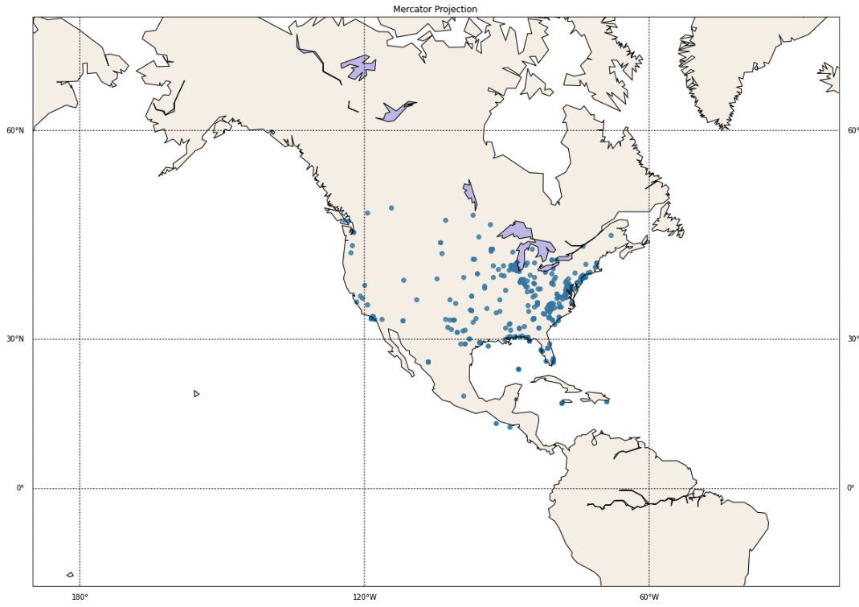
Plotting True Predictions of the Tweets locations

Slide 15
Conclusion
Best Model : Logistic Regression
‌Best Vectorizer: CountVectorizer
Create a model that has 96.2% recall towards new data(test data)
Compared to the base model, we were able to increase the overall accuracy from 57.7% to 97.3%.

Slide 16
Recomendation
Having the real-time geo-location of the tweets is crucial as it would be difficult to map otherwise.
It would be helpful to have information about the timing of the tweets and using the frequency of tweets in a given time span to gauge how urgent the emergency is.

Slide 17
Thank You

